Slide 1
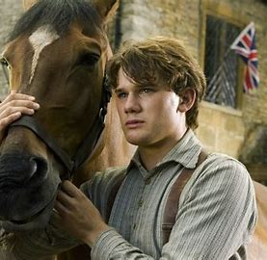
War Horse (2011)
By Student B

Slide 2
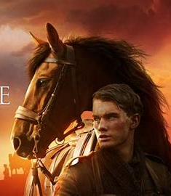
Summary
War horse a movie shown at the start about a boy and his horse later on we see that the father of the boy sells the horse to the army at the start of WW1 we see from then on that the horse is lost by the British and is taken into a Prussian army base to pull canons around. Later in the movie we see the horse trapped in no man’s land under barbwire he's then saved just to be nearly put down until the original owner whistles to him and is treated by the army vet. He's then sold to an old man and given back to the young boy.

Slide 3
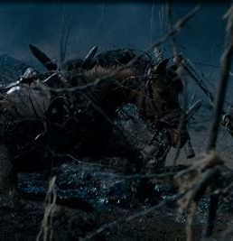
Scene Analysis Camera
The angles of cameras was mainly based at a close to far short with very few close ups and had one or two high shots showing the debris in the background these shots showed the gruesome reality that no one was winning this war.

Slide 4
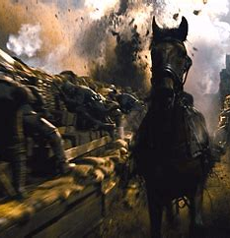
Acting
In the scene where one solider from the British and one from Germany go into no man’s land without their weapons to free a horse that’s stuck in between barbwire these 2 people are helped by both sides when they pass wire cutters to them. The two soldiers talk about how they felt the war was going and who was in the right they discuss their experiences with fighting and complain about who was leading them. After they had freed the horse they debated who should own said horse they gave it up to a coinflip the brit solider won and took the horse back. The scene is incredibly important to the rest of the story and let Albert Naracot have his horse once again

Slide 5
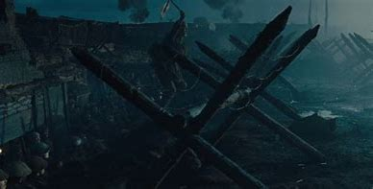
Mis en scene
This scene uses wooden junk and barbwire this shows the hell that is between these two trenches and how terrible it has been to them you can see the bodies of bot German and British soldiers. You can see the trenches in the back with people peeking out to see what is happening. When he was first leaving the trenches in that scene we see the people around tired hurt and completely dumbfounded when he pulls out white fabric to make a white horse.

Slide 6
editing
They use editing into making the horse scramble and scream but also at the start when he was being shot at the very start when they are trying to scare him back to the trenches. They use the horse as this compelling force to show that this horse can and has gone thought everything bad it could besides being killed. Except in the book where he was klled.

Slide 7

Lighting
The lighting in the scene is a darkish blue and grey with light stopping the light from getting through. This showed that it was night and that it has fires lighting the area around the background you could tell they pointed more of the lights on the horse to show its full body under the mess they use a darker colour to show the dismay of the surrounding area and to show how this war was really going instead of how people really saw it.

Slide 8
Sound
In this scene we hear nothing but them talking the horse and the rattling of metal and wood. This is to present the movement of them cutting the wire and when the horse gets cut or scrapped. The wind in the scene is quite but you could hear the wails when hitting fabric and plastic.

